Slide 1
Subreddit Comment Analysis
NLP - Topic Modeling
By Benson Chen
Aug 23, 2019
Notes:
Thank you for coming, I am Benson. Today’s topic applying topic modeling on comments from league of legends subreddit.

Slide 2


Goals for this project
Explore
Culture
Topics
Trending
Apply
Business Applications
Notes:
League of legends(lol) is a multiplayer online battle arena video game. My goals is to explore the the culture, the topics and trending of the the subreddit. Also, use final model for business application.

Slide 3
Project Workflow
Tool: CountVectorizer
Stop words: 400+
Token: 2grams
Max Features = 40,000
Finding from topic modeling
Flask App
Data Collection
EDA
Text
Preprocessing
Topic Modeling
Finding
and
Application
Where: Subreddit
ID: League of Legends
Method: Pushshift.io API
Range: 7/1/18 – 6/30/19
Data: 6.7 millions Comments
Tool: CorEx
Unsupervised
Semi-Supervised
Input: 1 million Comments
Notes:
Here is the project workflow, I use pushshift API to download all LoL subreddit comments from Jul 2018 to Jun 2019. In total 6.7 millions comments. For text preprocessing, I set 400+ stop words, 2gram and limit max features to 40K. I use CorEx for Topic modeling. Finally, create a flask app with final model.

Slide 4
LOL Basic – Map and Positions
Notes:
Before we move to EDA, I have to teach you some basic of the game. This is the map. Blue team and red team fight aganist each other. Each team have 5 players and each of them control 1 hero. For position of team, normally 1 person defending top and mid, 2 at the bottom and 1 just handing around the jungle. The game ended when a team is defeated.

Slide 5
EDA - Most Common Words
Counts do tell a story
Favorite Map Position: Top Lane
Game Developer: Riot Games, Inc
Damage! More Damage!
Popular Teams: TSM, SKT, G2, TL
Moderate amount of F words
Notes:
With that in mind, let’s look at the most common words of the subreddit in 2019 after droping the stop words. Top lane is the most favorite position. People keeps commenting about the riot, the game developer for good or bad. For game features, damage is all they care about. Some popular professional team are TSM SKT. As we can tell, this subreddit does a good job focusing on the game with moderate use of impolite word.

Slide 6
Topic Modeling using CorEx
Unsupervised
Semi-Supervised
Topic 1: gameplay/hero/item
Damage, ult, ap, passive, tank
Topic 1: hero
Yummi, akali, sona, pyke, yasuo
Topic 2: skin/links/Junks
Skins, http, www, com
VS
Topic 2: skin/links/junk
Skins, buy, money, www, com
Topic 3: team/tournament
G2, TL, NA, worlds, vs
Topic 3: team/tournament
NA, TL, IG, SKT, MSI
Topic 4: positions/pick
Mid, top, adc, pick, solo,
Topic 4: positions/gameplay
Top, mid, support, gank, carry
Topic 5: ranked matches
Elo, gold, diamond, plat, silver
Topic 5: ranked matches
Gold, elo, ranked, silver, diamond
Notes:
I used CorEx for my topic modeling because a comment could either mix with a lot of topics or no meaning. CorEx does a job even without anchors. As you can see, I am able to name each topics by looking at the top words. To make it better, I guided it with anchors. Topic 1 is showing all heroes and topic 4 is now combining gameplay and positions.

Slide 7
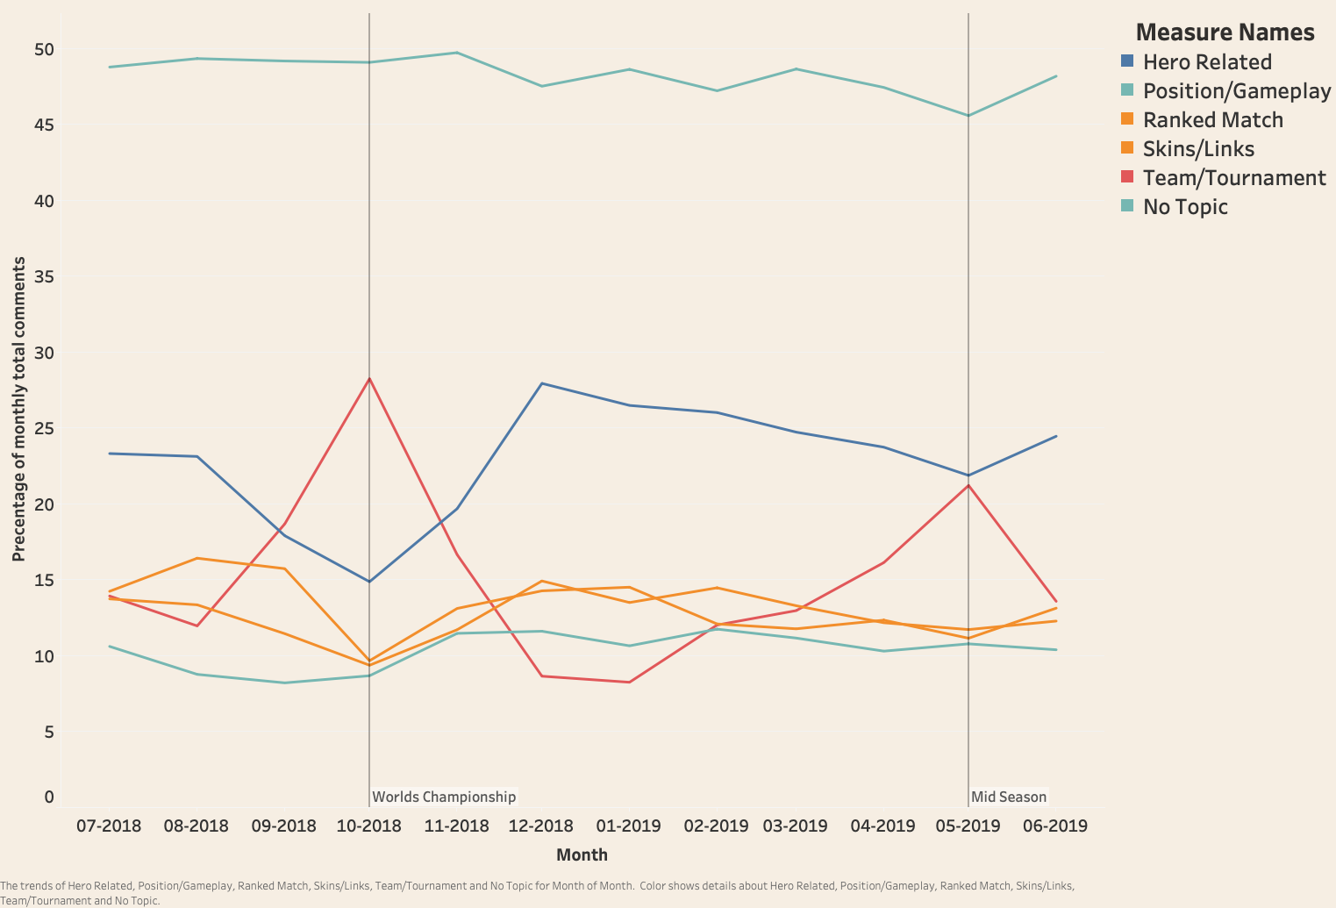
Topic Distributions by Month
Notes:
I transform one year of comments with the 5 semi-supervised topics. X-axis is month. Y is the percentage of comments belongs to a particular topic. Around 50% of comments have no topic. During the period world championship and mid season match. Comments regarding to professional team and tournament went up and discussion of other topics decrease. For the world championship in October 2018. There are 200 millions people watch the final match online. The price pool was 6.5 million dollar. The champion team IG from China take home with 2.5 millions dollars. Which make me wonder am I playing the same game.

Slide 8
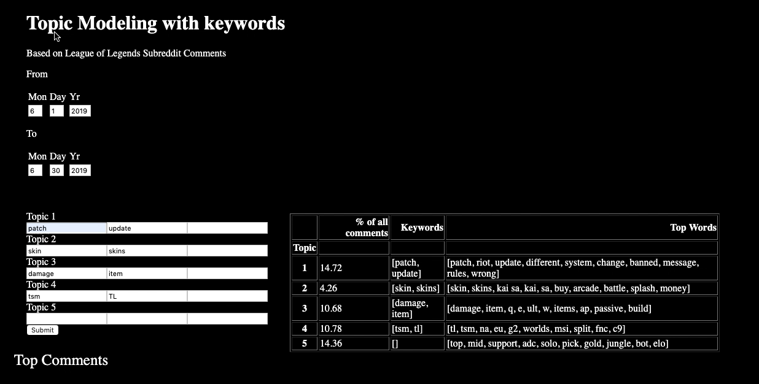
Notes:
I build a flask app depend on the CorEx model. You can pick a date range. Input some keywords for each topic. Submit. You will get a table showing top words for the topics. On second topic related to skin, we can see kaisa a champion show up. There might be a problem that kaisa's skin and people like arcade skins. It also output a table of comments related to each topics.

Slide 9
Thank You!

Slide 10
Appendix

Slide 11
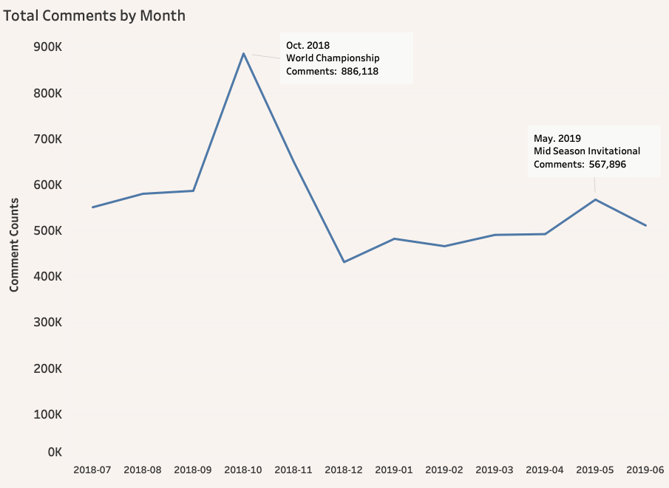
EDA – Counts of Comments
Notes:
Moving on to EDA, we have a graph here, X is the month, y is the total counts of comment of a month. The average is around 500K per month. There are two months with big increase in counts. Because two major international tournaments during those period.

